Slide 1
Use of Demographic Data in Analysis of School Projects
2024
Notes:
Good morning,
I am going to talk about some of the demographic and socioeconomic variables we examine in evaluating school projects.

Slide 2
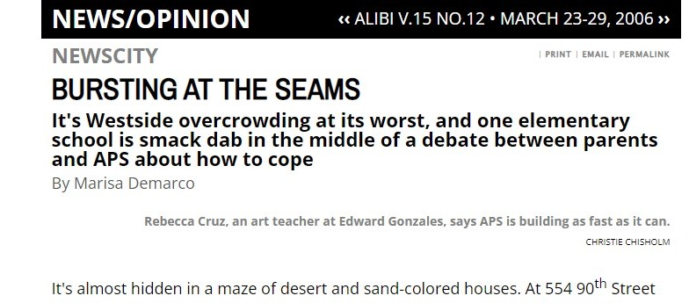
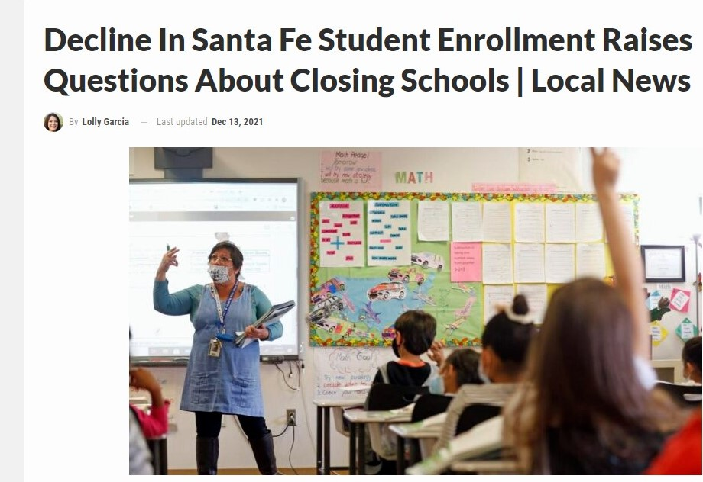
Notes:
Why do we need to consider demographic data and socioeconomic trends in our school district communities?
We don’t want to overbuild and/or underbuild.
As we have seen from various headlines over the past 15 years, we may experience various enrollment/population based scenarios in our schools.
For example, 10-15 years ago, Albuquerque’s west side was experiencing rapid residential development that created overcrowding in some of their schools.
More recently, some districts are facing enrollment decline, which leads to underutilized facilities that may strain local budgets.
Trying to build for the appropriate enrollment is crucial
Building too much space and the district has excess square footage to maintain and operate.
Building too small and we may need to bring in portables and we may not have solved the issue

Slide 3
Enrollment Projections
Enrollment projections necessary to determine the type of project the school may need.
We examine five years into the future
While the previous enrollment trend number shows incremental growth, this projection shows a nearly 100 student increase – why?
Notes:
We typically project an enrollment five years into the future.
In this example, we see incremental growth in each grade level, something that the model expects to continue.
However, the shaded yellow figure shows a sharper increase - we need to examine why this could happen.

Slide 4
Enrollment Projections - Inputs
Historic enrollment data – at least 10 years to determine trends
Birth data – helps determine kindergarten enrollment
Educational programs at school or in district
School boundary data and student location
Demographic/Socioeconomic variables
Housing construction, location, residential zoning
Industry expansion/retraction – employment & economic development
Migration patterns – are people moving in/out of the community?
Institutional presence – military bases, universities
City/County growth trends
Age groups in the community population – younger/older
Other Educational Options (BIE, charters, private schools)
Capacity/Utilization at other district schools
Unanticipated Occurrences – pandemic
Regional/county/municipal/tribal planner input
Notes:
This slide identifies different variables demographers use to create enrollment projections.
Highlighted in green are the science components – actual data from historic enrollment trends for each district and the individual schools within the district.
Demographers will typically plug this data into a model to establish existing trends – what the enrollment has done in the past three years, five years, ten years.
Demographers will then examine the other variables to see what influence, if any they have on the enrollment trends that may forecast additional growth or potential decline.
Housing
Industry
Other providers – private school, home school, other governmental entity
COVID
Next I will discuss how demographers use the data to formulate enrollment projections.

Slide 5
Enrollment Projections Inputs- Demographic
Historic enrollment data – at least 10 years to determine trends
Birth data – helps determine kindergarten enrollment
Age groups in the community population
Older – Could lead to lower birth rates
Younger – Could lead to higher birth rates
Migration Patterns
Moving in to community
Moving out of community
Census Tract data
Notes:
This slide identifies different variables demographers use to create enrollment projections.
Highlighted in green are the science components – actual data from historic enrollment trends for each district and the individual schools within the district.
Demographers will typically plug this data into a model to establish existing trends – what the enrollment has done in the past three years, five years, ten years.
Demographers will then examine the other variables to see what influence, if any they have on the enrollment trends that may forecast additional growth or potential decline.
Housing
Industry
Other providers – private school, home school, other governmental entity
COVID
Next I will discuss how demographers use the data to formulate enrollment projections.

Slide 6
Enrollment Projections Inputs – Educational
Educational programs at school or in district
Magnet – Attracts students from outside school attendance zone
Pre-K services
Specialized services (special education)
School boundary data and student location
How many kids reside in the neighborhood?
How many neighborhood kids leave for another school location and how many kids attend the school from outside neighborhood?
Other Educational Options (Bureau of Indian Education, charters, private schools)
Capacity/Utilization at other district schools
Do district schools have vacant classrooms and how can we best utilize these vacant rooms?
Notes:
This slide identifies different variables demographers use to create enrollment projections.
Highlighted in green are the science components – actual data from historic enrollment trends for each district and the individual schools within the district.
Demographers will typically plug this data into a model to establish existing trends – what the enrollment has done in the past three years, five years, ten years.
Demographers will then examine the other variables to see what influence, if any they have on the enrollment trends that may forecast additional growth or potential decline.
Housing
Industry
Other providers – private school, home school, other governmental entity
COVID
Next I will discuss how demographers use the data to formulate enrollment projections.

Slide 7
Enrollment Projections Inputs - Economic
Demographic/Socioeconomic variables
Housing construction, location, residential zoning
Industry expansion/retraction – employment & economic development
Institutional presence – military bases, universities
City/County growth trends
Age groups in the community population – younger/older
Regional/county/municipal/tribal planner input
Development location/subdivision/housing
Infrastructure development – could lead to new development
Comprehensive and area plans that may have growth projections and service needs
Neighborhood information
Notes:
This slide identifies different variables demographers use to create enrollment projections.
Highlighted in green are the science components – actual data from historic enrollment trends for each district and the individual schools within the district.
Demographers will typically plug this data into a model to establish existing trends – what the enrollment has done in the past three years, five years, ten years.
Demographers will then examine the other variables to see what influence, if any they have on the enrollment trends that may forecast additional growth or potential decline.
Housing
Industry
Other providers – private school, home school, other governmental entity
COVID
Next I will discuss how demographers use the data to formulate enrollment projections.

Slide 8
Enrollment Projections – A Science and an Art
Science
Utilizes Actual Numbers – Births and Past Enrollment
Establishes Trend that Forms Basis of Enrollment Projection
Art
Examines Other Variables At Work in the Community
Makes Adjustment to the Trend and Projection Based on These Variables
Taken Together - Informs decision making
Do we need a new or replaced school and at what capacity?
Do we only need an addition?
Do we need to adjust attendance boundaries to relieve overcrowding at one school and improve utilization at another?
Do we have too much space and need to consolidate or repurpose?
Notes:
Talk to anyone who works with school demographics and enrollment projections and they will tell you projection a school and district’s enrollment is both a science and an art.
The science pertains to enrollment projection models that uses actual enrollment trend and birth data to create a baseline enrollment projection.
The art examines other factors in the community and school district, which the demographer uses to adjust or supplement the baseline enrollment projection.
For example, is the district experiencing residential development and what effect may this development have on the enrollment trends district wide or at an individual school.
Taken together, the science and art of enrollment projections inform decision making

Slide 9
Establishing the Baseline: Births (Science)
Birth Trends
National and state decline in birth rates (Since Great Recession)
Demographers appear to be split as to when and if this trend will reverse
US society is aging
People putting off having kids = smaller families
At some point, it will level out
Notes:
We’ll start with births
Birth are important since they correlate directly to the kindergarten class size in our school districts five years later.
I am sure you have heard that most of our school districts are experiencing enrollment declines.
Declining birth numbers nation wide is among significant reasons why our districts experience enrollment declines
You see in 2007, we had 30 K births. In 2020, that number fell to 21 K, that is 8700 less kindergarteners entering our schools.
It’s not only a New Mexico issue, it is a national issue.

Slide 10
Establishing the Baseline: Births (Science)
Examines births by County
Compares births to kindergarten enrollment five years later
Establishes trend data we use to project kindergarten enrollment
Data collected based on mother’s address from NM Department of Health
Notes:
For the births, we look at births in a county and compare it to a district’s kindergarten enrollment five years later to create a ratio or multiplier.
In this example, we look at San Juan County’s births and compare it to Farmington municipal school district’s kindergarten enrollment.
You can see the effect of the lower birth numbers on the kindergarten enrollment.
We also see that on average, Farmington receives about 44% of all County births in its kindergarten class with the remainder going to Aztec, Bloomfield, Kirtland, and/or other educational providers.

Slide 11
Establishing the Baseline: Historic Enrollment (Science)
Examines trends on both district level, school level, and grade level
Reviews enrollment from one year to the next in order to establish trends
Data is useful for our enrollment projection model called “Cohort Survival Projection”
Notes:
Next we look at enrollment trends among a district’s grade levels and individual schools.
Specifically, we look at enrollment in one grade level in one year and compare it to enrollment in the next grade level the following year.
This type of analysis forms the Cohort Survival model, which demographers use as the industry standard method of forming a baseline projection for our schools.

Slide 12
Cohort Survival Model (Science)
Basic premise is that historic trends will influence future enrollment
Examines each grade level in a school and the number of students who progress from one grade level to the next the following year in a school and district.
Progression leads to “survival rates”, which are used as multipliers to project future trends
Establishes a baseline projection. Adjustment of the cohort rates may be necessary if district or school is experiencing rapid change

Slide 13
Establishing the Baseline: Cohort Survival Method (Science)
Primary method to project school enrollment
Treats grades as “cohorts” and monitors them as they progress over school years
Establishes a “survival ratio” for each grade level to use as a multiplier to project enrollment
100 second graders in a school become 105 third graders – survival ratio = 1.05
Chart tells us historically, 1st gains students from Kindergarten
Survival ratios, on average of 1.1, suggest stability to growth over the next five years
Notes:
For example,
We follow, if you look at the blue shaded boxes, you can follow a cohort entering a school at kindergarten and see how they advance through each grade level.
In this example, we see that the first grade typically gains student from the previous kindergarten class the year before.
We calculate a survival ratio for first grade by diving the first grade class by the kindergarten class the year prior.
In this example, the first grade survival ratio is 1.1, which suggest stability to growth in the first grade.
We create a similar ratio for each grade level.
We then use a ratio as a multiplier in which we take the existing enrollment and multiply it by the ratio to get a baseline projection.

Slide 14
Enrollment Projections: Art
Examination of Other Variables:
Development
Attendance Boundary Adjustment
Migration Patterns
School Capacity
General economic conditions
Leads to Adjustment in cohort survival rates
Notes:
This is where the art comes in.
In this situation, the demographer examined
development occurring in this school’s attendance boundary and in adjacent attendance boundaries with a student yield estimate
Capacity of schools in this area, which revealed that the resulting development could put a strain on available capacity.
As a result, the demographer recommended the district adjust its attendance boundaries as well as replace a school with a larger capacity.
But this will lead to an adjustment of the school’s baseline cohort survival model.

Slide 15
Enrollment Projections: Art
Resources:
School District Facilities Master Plan
UNM Geospatial and Population Studies
US Census Bureau/American Community Survey
Office of Economic Adjustment (Department of Defense)
Municipal/County/Tribal/Regional Planning Departments
NM Public Education Department
NM Department of Health/Vital Statistics
Notes:
This slide provides some sources a school demographer may use in forecasting a school’s enrollment

Slide 16
Challenges in Enrollment Analysis and Projection
Land uses may change
Births are difficult to forecast over long term
Parent decisions are hard to forecast
School may change its program
Neighborhoods change over time
Is it a “bubble”?
Projections may not come to fruition – requires monitoring at various steps of the planning process – don’t want to overbuild/under build
Other school entities – private/BIE/charters could impact projections and capacity/utilization
Large employer may leave, arrive, change (i.e. military base may add a mission)
Housing may or may not always translate into kids – Student yield ratio
Notes:
This slide contains some challenges in forecasting enrollment:
Some times we see projections accurate when compared to actual enrollment numbers. Other times, we may see wide variations. It does not necessarily mean the demographer did anything wrong, but it could mean conditions changed rapidly.
A large employer may leave or arrive suddenly
Housing may take more time to generate kids
Parent decisions hard to forecast.
Neighborhoods may change – a neighborhood filled with kids may not regenerate – kids grow up, parents age in place.

Slide 17
Enrollment Growth or Decline: Impacts on Space
Enrollment loss or growth does not necessarily mean empty/overcrowded classrooms:
Growth/decline of 50 students appears to suggest the need for two classrooms or two vacant classrooms
It could but needs further examination
A group of 50 students often does not fall into precise cohorts (i.e. 25 2nd graders/25 3rd graders)
More likely the 50 student growth/loss spread across each grade level/classroom
This could mean a school with Pre-K-5th (7 grade levels) with two classrooms/grade level = 4 empty seats per classroom

